Slide 1
Use of Control Samples in Seed Testing Bryce Callighan Melissa Phillips Monsanto - Waterman
AOSA/SCST April 2014 Webinar

Slide 2
Control samples can be a useful tool in the lab to ensure testing parameters were maintained or performed as expected.
We will talk about
How to select seed
How to determine frequency
How to use control charts

Slide 3
Question
How many attendees or labs currently use control samples?
Yes, we use
No, we do not

Slide 4
Scenario
You are a hard working member of AOSA/SCST who just evaluated a sample with a 56% germination score.
Should the sample be retested?

Slide 5
Scenario – Cont.
A
No control sample used
Submitted Sample Test Result = 56% germination
Result Reported- Unreliable
B
Control Sample significantly lower than expected
Submitted Sample Test Result = 56% germination
Process Failure- Retest
C
Control Sample performed as expected
Submitted Sample Test Result = 56% germination
Result Reported- Data Reliable

Slide 6
The Why
These samples are a “known” or a reference of what should be.
These samples are expected to behave in a predicted way in each test situation.
When these samples behave in an unexpected way, it can be used as an indicator that there was variation within the testing process.
This can be used to verify that a process was executed as required and that the data from that test is reliable.

Slide 7
The Why cont.
When you use control samples that behave in an expected manner, “Real” sample data even if unexpected can be a reliable result.
Process control samples can be used as a baseline for any improvements or problem solving measures performed in the lab

Slide 8
A Tale of No Reference - True Story
Purchased an expensive & award winning bottle of cider I had never had before.
Expected- An amazing beverage.
Actual Outcome- Worst. Taste. Ever.
Assumptions- Bottle was bad, bad batch, it had sat in my trunk on a hot day.
Bought another bottle- Still bad
Without a control or a reference I was unable to accept that the cider was supposed to taste that way, and had to do an expensive unnecessary “retest" to confirm initial outcome.

Slide 9
When to use control samples
ID critical processes that can be affected by minute changes within test constraints
Vigor Tests
For example: Accelerated Aging
Time and Temp play a huge factor in outcomes
In your lab you will need to identify and understand
Processes at risk for variation
Determine what part of the process is at highest risk of compromising the test. This is to be monitored and the frequency established.
Per day, per chamber/germinator, per test, per crop/test condition, ect.

Slide 10
How to select control samples
Identify two lots to use per crop/test condition
Don’t always choose the highest quality lots.
High vigor seed may perform well even with additional stress.
High vigor seed that always performs well in normal stress conditions won’t alert you if a test under-stressed the seed
Don’t go too low in quality
Too low in quality could result in a higher standard deviation which could mask any alarms.
Why two?
Changes of 1 sample may just be due to the seed lot, where changes that affect both lots can easily be attributed to the testing process.
Notes:
Evaluators, abnormal

Slide 11
Some Terminology for Process Control Charts
Mean – The average of your control samples
Standard Deviation (Sigma) – How much variation there is from the mean. Two sets of tests can both have an average of 80, but have different Standard Deviations
Test 1: 90, Test 2: 70. Mean = 80, StDev = 14.14
Test 1: 82, Test 2: 78. Mean = 80, StDev = 2.83

Slide 12
Some Terminology for Process Control Charts
UCL and LCL – Upper and Lower Control Limit. This is 3 x the Standard Deviation.
Alarm – When a data point is outside of the UCL or LCL. Also when a data trend violates a set of rules.
For rules
http://www.sqconline.com/about-control-charts

Slide 13
Tips
Replace your control samples annually to avoid a sudden drop off in quality
If possible, don’t change control samples during your busy season
If you have a lot of species in a lab, identify the most susceptible or high impact species. If you only test a species a handful of times, you probably don’t need a control sample of that species
Notes:
Mean shift

Slide 14
Conclusion
Regardless of type of lab that you are in…
Private, Regulatory, Independent
The key to our success is data integrity, reliability and repeatability for our customers
The use of control samples enables us to achieve this.

Slide 15
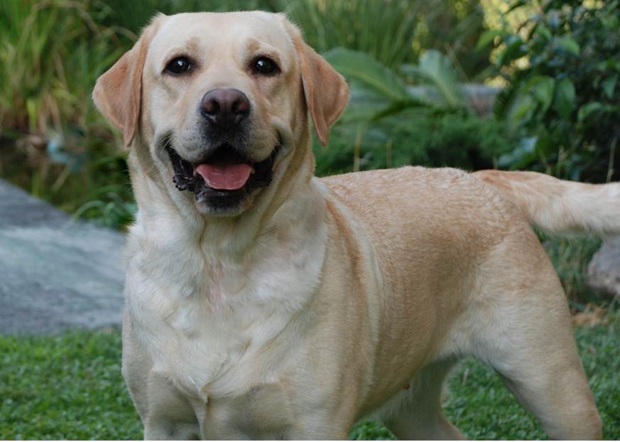
Standard
Questions?

