Slide 1
AOSA/SCST Asteraceae, Sunflower family I Lettuce Seedling Evaluation Handbook Committee
Lettuce Seedling Evaluation Webinar
Presented by Elizabeth Bada, November 14,2013

Slide 2
AOSA RULES
Lactuca sativa, lettuce (The committee’s proposed changes are in black font.)
GENERAL DESCRIPTION
Seedling type: Epigeal dicot.
Food reserves: Cotyledons that expand and become thin, leaf-like and photosynthetic. Some varieties develop elongated petioles at the base of the cotyledons.
Shoot system: The hypocotyl elongates and carries the cotyledons above the soil surface. The epicotyl usually does not show any development within the test period.
Root system: A long primary root.

Slide 3
Essential seedling structures

Slide 4
Abnormal Seedling Description
Cotyledons :
less than half of the original cotyledon tissue remaining attached.
less than half of the original cotyledon tissue free of necrosis or decay (see notes 5, 6 and 8).
cotyledons that are swollen, curled, or deformed. (Added to harmonize with ISTA.)
Epicotyl:
missing (may be assumed to be present if cotyledons are intact).
any degree of necrosis, decay or damage at the point of cotyledon attachment.
Hypocotyl :
deep open cracks extending into the conducting tissue.
severely twisted or grainy.
watery.
malformed, such as markedly shortened or thickened. (Added to harmonize with ISTA.)

Slide 5
Abnormal Seedling Description
Root:
none.
primary root tip blunt, swollen and discolored.
primary root with splits or lesions.
weak, stubby or missing primary root (secondary roots will not compensate for a defective primary root).
Seedling:
swollen cotyledons associated with extremely short hypocotyl and root.
one or more essential structures impaired as a result of decay from primary infection.
albino
yellow (applies to individual discolored seedlings in the replicate.) (Added to harmonize with ISTA)

Slide 6
Notes
1. Toxic materials in the substrate will cause short, blunt roots. The roots lift away from the substrate. Check media for toxicity and conduct retest if necessary.
2. Seedlings grown on top of white filter paper will be shorter than those grown on dyed blotters. Retest if necessary.
3. Remove attached seed coats for seedling evaluation.
4. Seedlings with slight dormancy or light sensitivity may be slow to germinate. Extend test according to the rules.
5. One type of necrosis on lettuce cotyledons is a physiological breakdown of the plant tissues, the cause of which has not been determined. It is manifested by discolored areas on the cotyledons, first appearing on or adjacent to the midrib and lateral veins, and should not be confused with the natural pigmentation of the different lettuce cultivars.

Slide 7
Notes
6. Seedlings with extensive physiological necrosis on the cotyledons may be slower in growth than those without such affected areas. Hypocotyl and root length may be affected by other factors such as proximity to light, delayed germination or dormancy.
7. Seedlings with three cotyledons should be considered as “normal”.
8. The 50% Rule must be followed to classify seedlings with mechanical damage (dark areas of discoloration or decay) as “abnormal” seedlings.

Slide 8
Virtual Lettuce Referee Review
The AOSA/SCST Seedling Evaluation Handbook Committee conducted a lettuce referee in 2012. The referee results were presented in Boise in May 2013. The presentation is available on the SCST website.
The referee photos have been classified by the Seedling Evaluation Handbook committee and will be reviewed along with some additional photos and evaluation criteria, in this webinar.
The Lettuce webinar will soon be available on the SCST website to view or download.
The different types of abnormal seedlings as described in the rules are represented in the photos.

Slide 9
Lettuce germination test

Slide 10
Assessment of Seedlings
Laboratory definition of germination;
In seed laboratory practice, germination is the emergence and development of the essential structures of the seed embryo that, for the kind of seed in question, are indicative of the ability to produce a normal plant under favorable conditions. The objective of the germination test is to determine the percentage of normal seedlings in the test. (See section 6.2 a. of the AOSA Rules for Testing Seeds Vol. 1.)

Slide 11
Assessment of Seedlings
Normal seedlings;
In general, seedlings are classified as normal if they have no defects or only slight defects that will not impair the continued development of the seedling or plant when grown in soil under favorable conditions. (See section 6.2 b. of the AOSA Rules Vol. 1.)

Slide 12
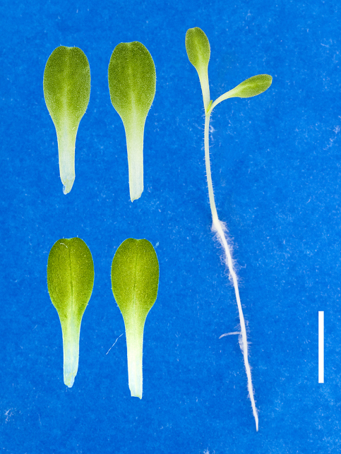
Image 2
Distribution of referee responses:
Normal: 100%
Abnormal: 0%
All essential structures are healthy and normal.

Slide 13
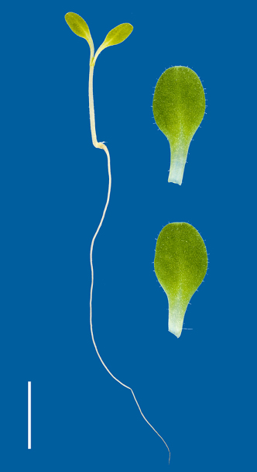
Image 22
Distribution of referee responses:
Normal: 97.2%
Abnormal: 2.8%
All essential structures are healthy and normal

Slide 14
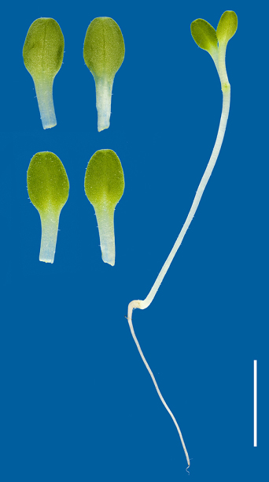
Image 11
Distribution of referee responses:
Normal: 90.1%
Abnormal: 9.9%
All essential structures are healthy and normal.
The hypocotyl is out of proportion to the root possibly due to it’s proximity to the light source. The replicates of a single test should be placed at an equal distance from the light source to avoid causing any discrepancy between replicates. Tests placed too far from the light will have seedlings that lean and reach toward the light causing an un-uniform stand with leggy hypocotyls and out of proportion seedlings.
This is a test condition and is to be considered normal.

Slide 15
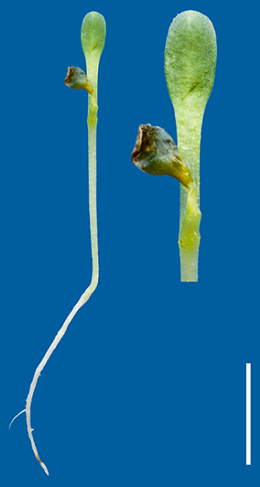
Image 26
Distribution of referee responses:
Normal: 56.3%
Abnormal: 43.7%
Normal with 50% functional cotyledon tissue, free of necrosis or decay, remaining attached.
The growing point is not visible and would need to be free of necrosis or decay to be normal. This classification is based on the cotyledons in this case.

Slide 16
Assessment of seedlings
Additional photo
Abnormal seedling with a decayed root.
This may be an effect of toxicity, possibly from the pelleting material. If the presence of these is 5% or more, consider a retest in a different media.

Slide 17
Assessment of Seedlings
Abnormal seedlings;
Seedlings are classified as abnormal if they have defects that will prevent them from developing into mature plants when grown in soil under favorable conditions. These defects are not to be considered abnormalities if they are caused by test conditions. To classify a seedling as abnormal an analyst must judge the defect to be so severe that further development of the seedling would be unlikely. Specific abnormalities are listed in seedling descriptions of Part II. (See section 6.2c of the AOSA Rules for Testing Seeds Vol.1.)

Slide 18
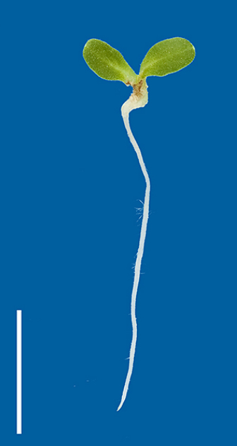
Image 21
Distribution of referee responses:
Normal: 2.8%
Abnormal: 97.2%
Abnormal due to decay at the point of attachment and a short, grainy or lesioned hypocotyl.
The hypocotyl surface appears grainy due to the abnormal cell division, creating a lesion during the development of the hypocotyl tissues.

Slide 19
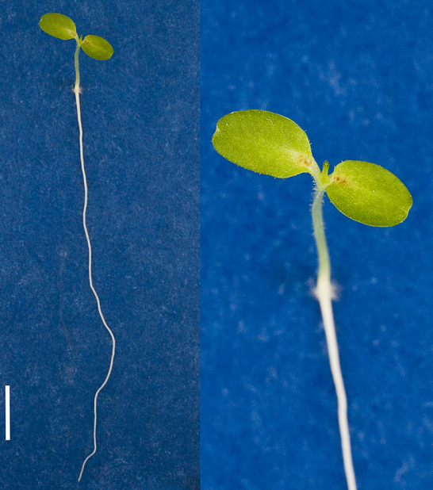
Image 25
Distribution of referee responses:
Normal: 42.3%
Abnormal: 57.7%
Abnormal due to a short, weak and watery hypocotyl.
This seedling also has less than 50% necrosis.

Slide 20
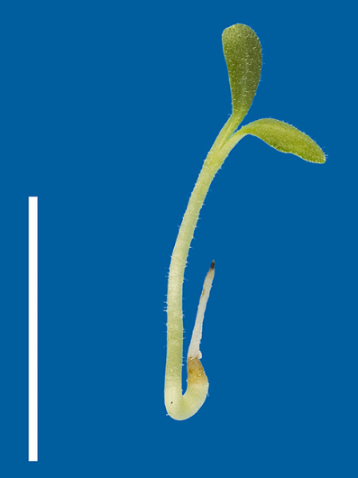
Image 13
Distribution of referee responses:
Normal: 2.8%
Abnormal: 97.2%
Abnormal seedling with a swollen hypocotyl and a short, blunt root with a decayed tip.

Slide 21
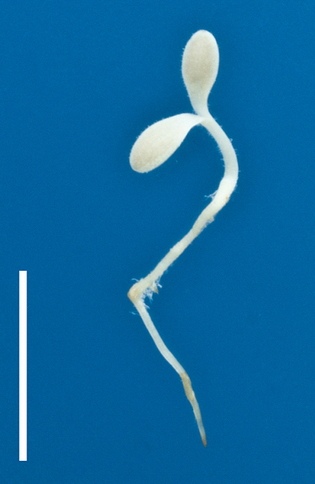
Image 8
Distribution of referee responses:
Normal: 1.4%
Abnormal: 98.6%
Albino is considered abnormal.
All tissues are white due to the absence of pigments. Cotyledons without chlorophyll cannot perform photosynthesis.

Slide 22
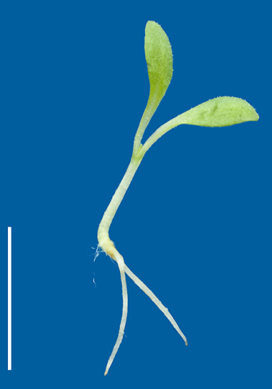
Image 19
Distribution of referee responses:
Normal: 21.1%
Abnormal: 78.9%
Abnormal seedling due to the split root.
The hypocotyl is swollen and lesioned at the transition point to the split root.

Slide 23
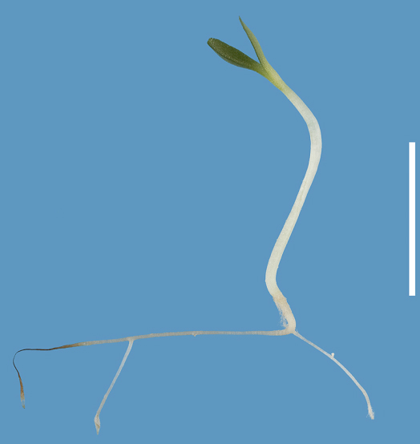
Image 7
Distribution of referee responses:
Normal: 44.4%
Abnormal: 55.6%
Abnormal with a decayed root. This may be an effect of toxicity.
Secondary roots will not compensate for a defective primary root.

Slide 24
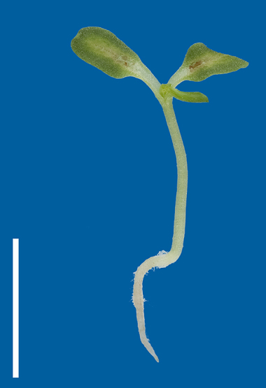
Image 16
Distribution of referee responses:
Normal: 20%
Abnormal: 80%
Abnormal seedling with a short, blunt root and a watery hypocotyl.
Less than 50% necrosis.

Slide 25
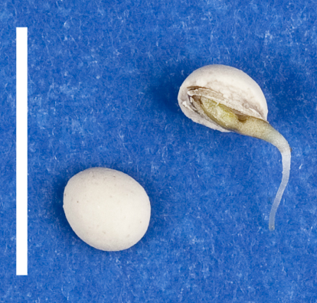
Image 27
Distribution of referee responses:
Normal: 0%
Abnormal: 100%
A late germinating , undeveloped seedling with decay at the point of attachment and a blunt watery root is abnormal.

Slide 26
Assessment of seedlings
Diseased and decayed seedlings;
Secondary infection is infection that does not originate with the seed or seedling itself, but rather from other diseased seeds or seedlings. Seedlings with any degree of secondary infection are to be classified as normal provided that all essential structures are present and otherwise normal (See section 3.5.5, part 1. of the AOSA Rules for Testing Seeds, Vol. 4.)

Slide 27
Assessment of seedlings
Diseased and decayed seedlings;
Primary infection originates from the seed or seedling itself. Seedlings with slight primary infection are considered normal provided development of none of the essential structures has been impaired. Seedlings with primary infection sufficient to impede development of one or more essential structures are to be classified as abnormal. (See section 3.5.5, part 1. of the AOSA Rules for Testing Seeds, Vol. 4.)

Slide 28
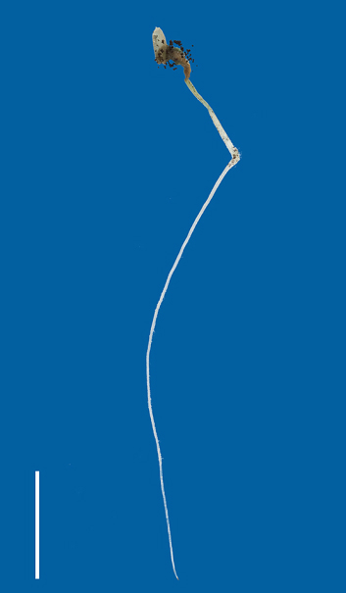
Image 4
Distribution of referee responses:
Normal: 0%
Abnormal: 100%
Abnormal with the essential structures decayed from primary infection.
The structures of the seedlings effected by the fungi turn mushy and decayed.

Slide 29
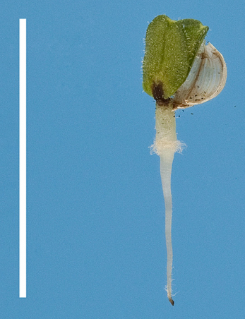
Image 5
Distribution of referee responses:
Normal: 0%
Abnormal: 100%
Abnormal with decay at the point of attachment.
When the point of attachment is decayed the seedling is abnormal and no further assessment is needed.

Slide 30
Assessment of seedlings
Physiological necrosis;
Physiological necrosis is an effect of ageing in lettuce. The exact cause is unknown. A seed lot with necrosis will continue to decline in vitality and shelf life. Poor storage conditions or stressing the seed will contribute to this decline. The presence of necrosis in the seed lot will increase over time.
Due to a physiological breakdown of the plant tissues, the cells die off and turn dark. Necrosis usually starts along the midrib and progresses up the lateral veins of the cotyledons from the base to the tip of the leaf.
The dark areas caused by physiological necrosis can appear as bubbly and bumpy or sunken leaf tissues.

Slide 31
Assessment of seedlings
Physiological necrosis
Physiological necrosis can effect the entire seed lot whereas mechanical damage or decay effects the individual seeds or seedlings.
Necrosis
The word necrosis means dead cells. It is important to determine if the dead or dying spot is physiological necrosis, mechanical, in other words physical damage, or decay.

Slide 32
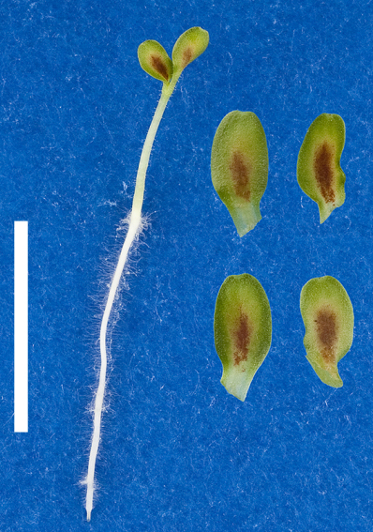
Image 28
Distribution of referee responses:
Normal: 35.7%
Abnormal: 64.3%
Abnormal due to less than 50% functional cotyledon tissue, free of necrosis or decay, remaining attached.
This seedling has more than 50% necrosis and chlorosis.

Slide 33
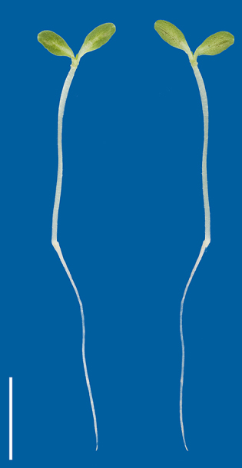
Image 23
Distribution of referee responses:
Normal: 85.9%
Abnormal: 14.1%
Normal seedling with more than 50% functional cotyledon tissue, free from necrosis or decay, remaining attached.
Acceptable defect in a slightly twisted hypocotyl.

Slide 34
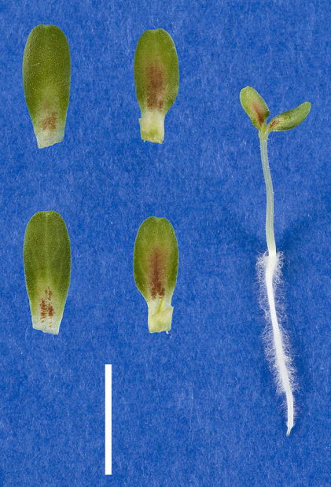
Image 18
Distribution of referee responses:
Normal: 32.4%
Abnormal: 67.6%
Abnormal due to the watery hypocotyl and the deformed root tip.
This seedling also has less than 50% necrosis.

Slide 35
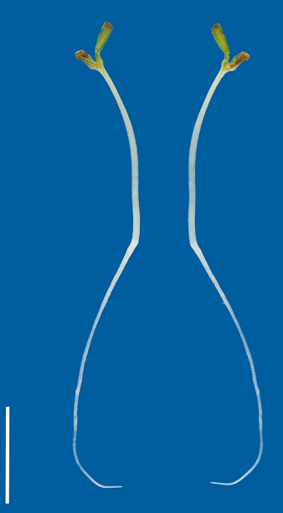
Image 20
Distribution of referee responses:
Normal: 4.3%
Abnormal: 95.7%
Abnormal due to less than 50% functional cotyledon tissue, free of necrosis or decay, remaining attached.
More than 50% physiological necrosis and mechanical damage.
This abnormal seedling has physiological necrosis at the growing point .
More than 50% mechanical damage on the cotyledons.

Slide 36
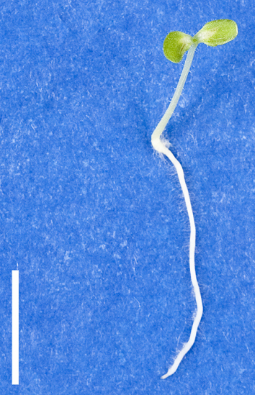
Image 12
Distribution of referee responses:
Normal: 78.9%
Abnormal: 21.1%
Normal seedling with more than 50% functional cotyledon tissue, free of necrosis or decay, remaining attached.
This seedling also has less than 50% necrosis.

Slide 37
Assessment of seedlings
Mechanical damage;
Handling during harvesting, processing or by rough handling with forceps in the laboratory can cause damage to seeds and therefore the embryonic plant.
Mechanical damage causes injured and bruised spots, which result in decayed areas on the seedling.
A mechanical damaged area should not be confused with decay from an infection which can appear wet and rotting. By comparison mechanical damage looks more like a crimped or pinched dark area of dead cells similar to a dried up leaf. (See section 3.4.4, part 1. of the AOSA Rules for Testing Seeds, Vol. 4.)

Slide 38
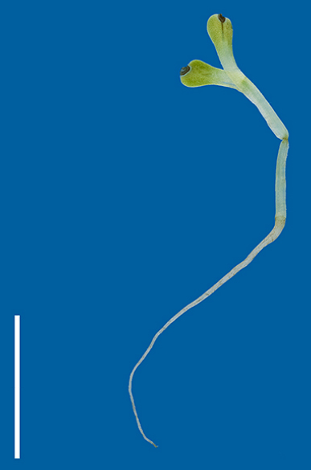
Image 24
Distribution of referee responses:
Normal: 12.7%
Abnormal: 87.3%
This seedling is abnormal due to the watery hypocotyl. (The pinched spot on the hypocotyl is from handling the seedling.)
The cotyledons have mechanical damage.

Slide 39
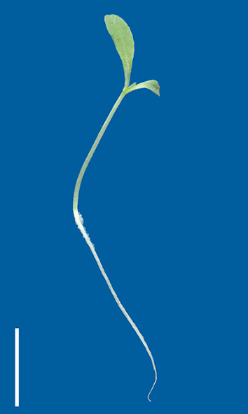
Image 14
Distribution of referee responses:
Normal: 98.6%
Abnormal: 1.4%
Normal with more than 50% functional cotyledon tissue, free of necrosis or decay, remaining attached.
One cotyledon is broken, the damaged edge is bruised from mechanical damage.

Slide 40
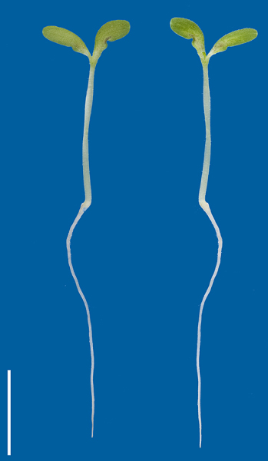
Image 15
Distribution of referee responses:
Normal: 78.9%
Abnormal: 21.1%
Normal seedling with more than 50% functional cotyledon tissue, free of necrosis or decay, remaining attached.
The cotyledons have less than 50% mechanical damage.
This seedling also has an acceptable defect in a slightly twisted hypocotyl.

Slide 41
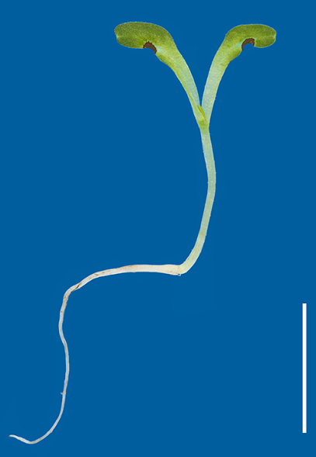
Image 17
Distribution of referee responses:
Normal: 66.2%
Abnormal: 33.8%
Normal due to more than 50% functional cotyledon tissue, free of necrosis and decay, remaining attached.
Less than 50% mechanical damaged.

Slide 42
Assessment of seedlings
Chlorosis;
A chlorophyll deficiency causing a lack of pigmentation which inhibits photosynthesis.
Chlorotic leaves look pale and greenish-yellow in color.
Can be in combination with necrosis.

Slide 43
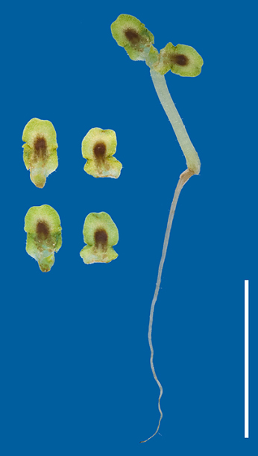
Image 9
Distribution of referee responses:
Normal: 8.3%
Abnormal: 91.7%
Abnormal with less than 50% functional cotyledon tissue, free of necrosis or decay, remaining attached.
More than 50% chlorosis and necrosis.
The hypocotyl is watery, swollen and damaged.

Slide 44
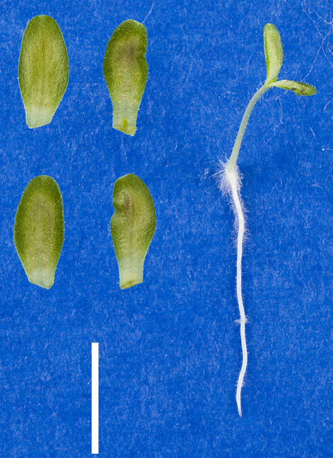
Image 3
Distribution of referee responses:
Normal: 77.5%
Abnormal: 22.5%
Normal with more than 50% functional cotyledon tissue, free of necrosis or decay, remaining attached.
The cotyledons have less than 50% necrosis

Slide 45
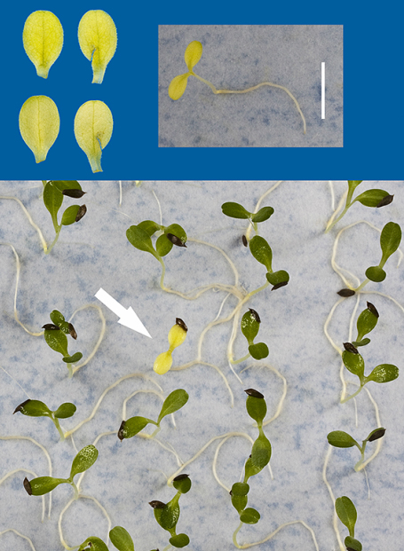
Image 6
Distribution of referee responses:
Normal: 33.3%
Abnormal: 66.7%
Abnormal seedling with yellow cotyledons due to chlorosis.
The chlorosis causes a chlorophyll deficiency.

Slide 46
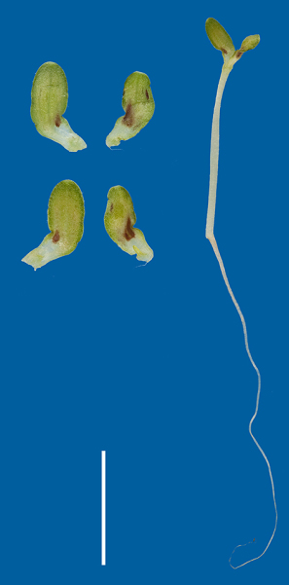
Image 10
Distribution of referee responses:
Normal: 59.7%
Abnormal: 40.3%
Abnormal with less than 50% functional cotyledon tissue, free of necrosis or decay, remaining attached.
More than 50% chlorosis and mechanical damage on the deformed cotyledons.

Slide 47
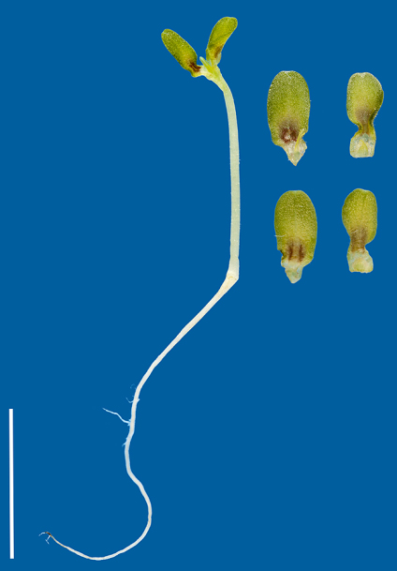
Image 1
Distribution of referee responses:
Normal: 54.9%
Abnormal: 45.1%
Abnormal with less than 50% functional cotyledon tissue, free of necrosis and decay, remaining attached.
Necrosis and watery at the point of attachment.

Slide 48
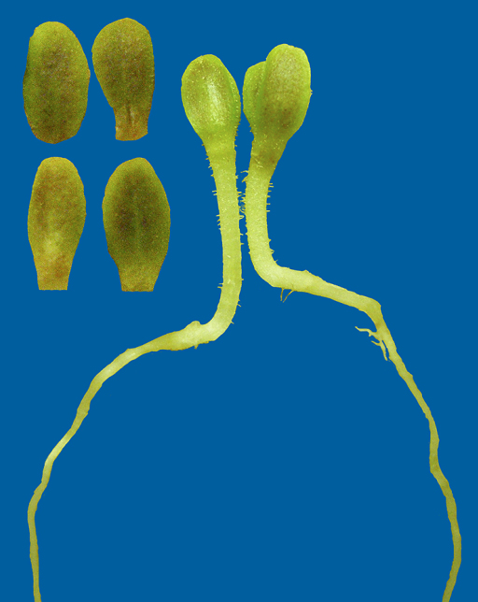
Image 30
Distribution of referee responses:
Normal: 53.7%
Abnormal: 46.3%
Normal seedling with a natural varietal pigmentation on the cotyledons.
Varietal pigmentation can appear as a raised freckling of color, which can be in shades of red or brown. Not to be confused with necrosis.
Seedlings from a greenhouse test may display varietal pigmentation, as shown in this photo, more often than a standard germination test due to the increased level of light exposure.

Slide 49
Conclusions
The referee results showed that on those seedlings with borderline plus or minus 50% necrosis the classifications being made are not uniform.
Once a seed lot has physiological necrosis the quality of the crop will be questionable only to decline further from there.

Slide 50
Conclusions
The referee results also showed that some analysts are classifying most of the dark areas on the lettuce cotyledons as necrosis and are not classifying the areas which have decay or mechanical damage as such. The decay or mechanical damage effects the individual seed or seedling whereas the physiological necrosis effects the entire seed lot.
In the new Seedling Evaluation Handbook the digital photos will offer clarification of the differences between decay, mechanical damage and physiological necrosis.
The new Seedling Evaluation Handbook will have adequate pictures with well defined parameters that will be easy for the analysts to correlate to their real life seedlings.

Slide 51
AOSA/SCST Asteraceae, Sunflower family I, lettuce
Seedling Evaluation Handbook Committee
Members:
Elizabeth Bada
Jane Kohn
Ha Ung
David Johnston
Connie O’Brien
Riad Baalbaki

